Slide 1

CODEMETRIC TECHNOLOGY
SWEN FORUMS
ALLEN, SCOTT NICHOLAS
180923 / 620099245
CLARKE, KHADEJA RENEE
180908 / 620098443
NEILL, MISCHKA ZOILA
180913 / 620100135

Slide 2
AGENDA
INTRODUCTION OF TEAM MEMBERS AND THEIR CONTRIBUTIONS TO THE PROJECT
OVERVIEW OF APPLICATION
BREAKDOWN OF APPLICATION
QUESTIONS AND COMMENTARY

Slide 3
INTRODUCTION OF TEAM MEMBERS AND THEIR CONTRIBUTIONS TO THE PROJECT

Slide 4
OVERVIEW OF APPLICATION

Slide 5
OVERVIEW OF APPLICATION
DATABASE
FIREBASE REALTIME DATABASE
CLIENT
BUILD LANGUAGES: JAVA, KOTLIN
TARGET SDK VERSION: 28
MINIMUM SDK VERSION: 25

Slide 6
BREAKDOWN OF APPLICATION

Slide 7
BREAKDOWN OF APPLICATION (cont’d)
USER AUTHENTICATION

Slide 8

USER AUTHENTICATION
HOME

Slide 9
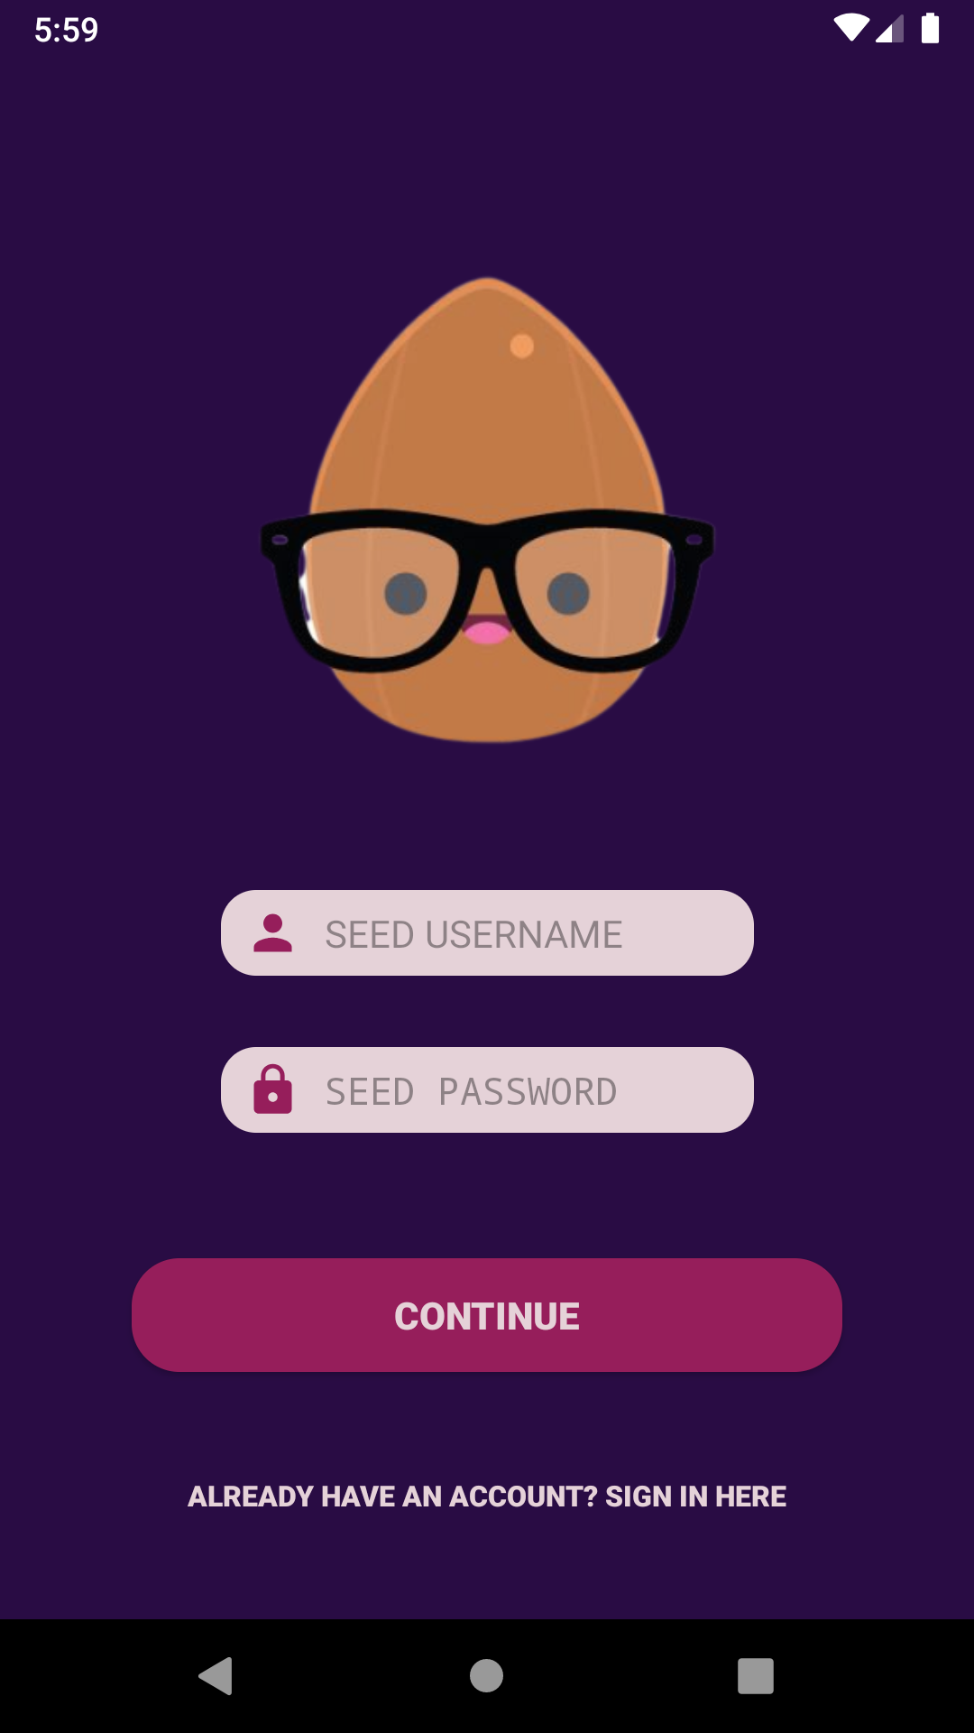
USER AUTHENTICATION
SEED AUTHENTICATION

Slide 10
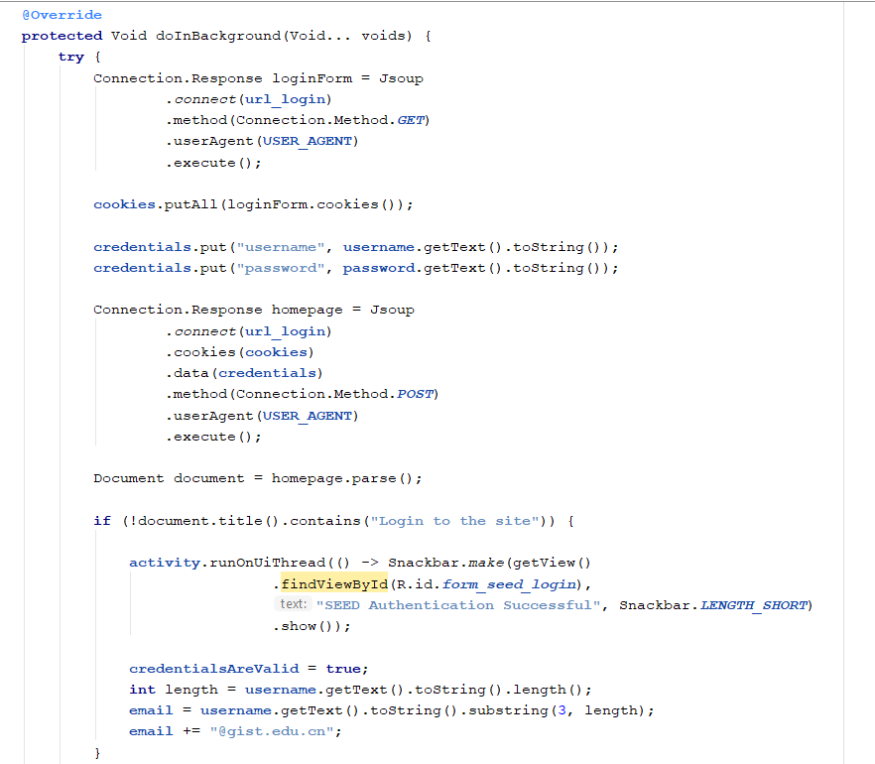
USER AUTHENTICATION - SEED AUTHENTICATION

Slide 11
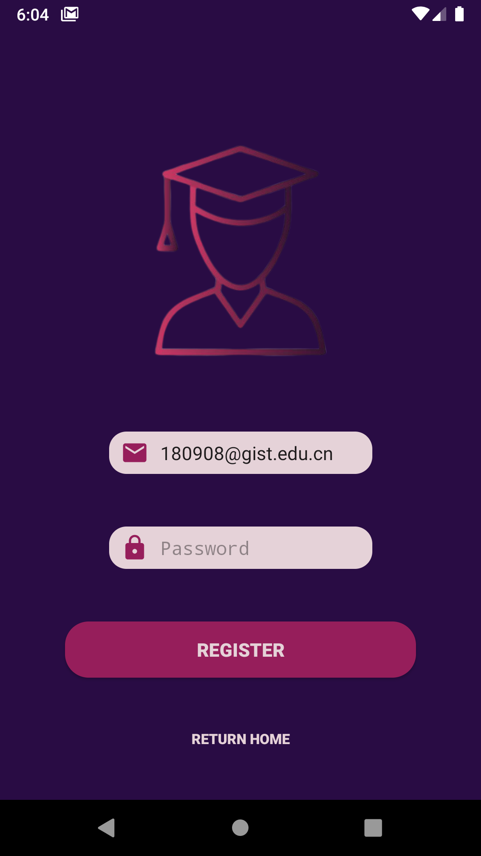
USER AUTHENTICATION
FIREBASE USER CREATION

Slide 12
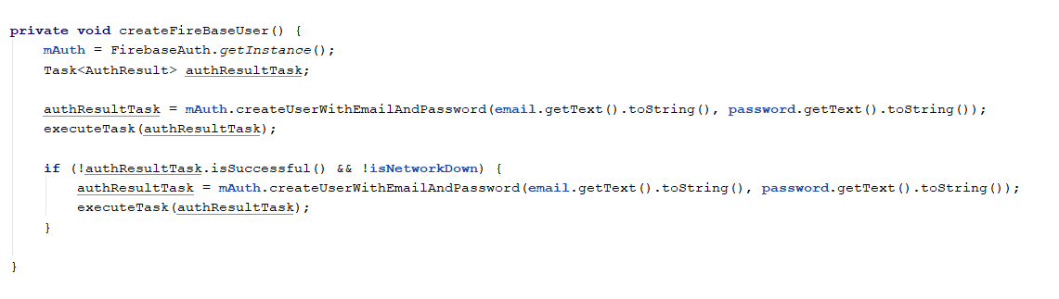
USER AUTHENTICATION - SEED AUTHENTICATION

Slide 13
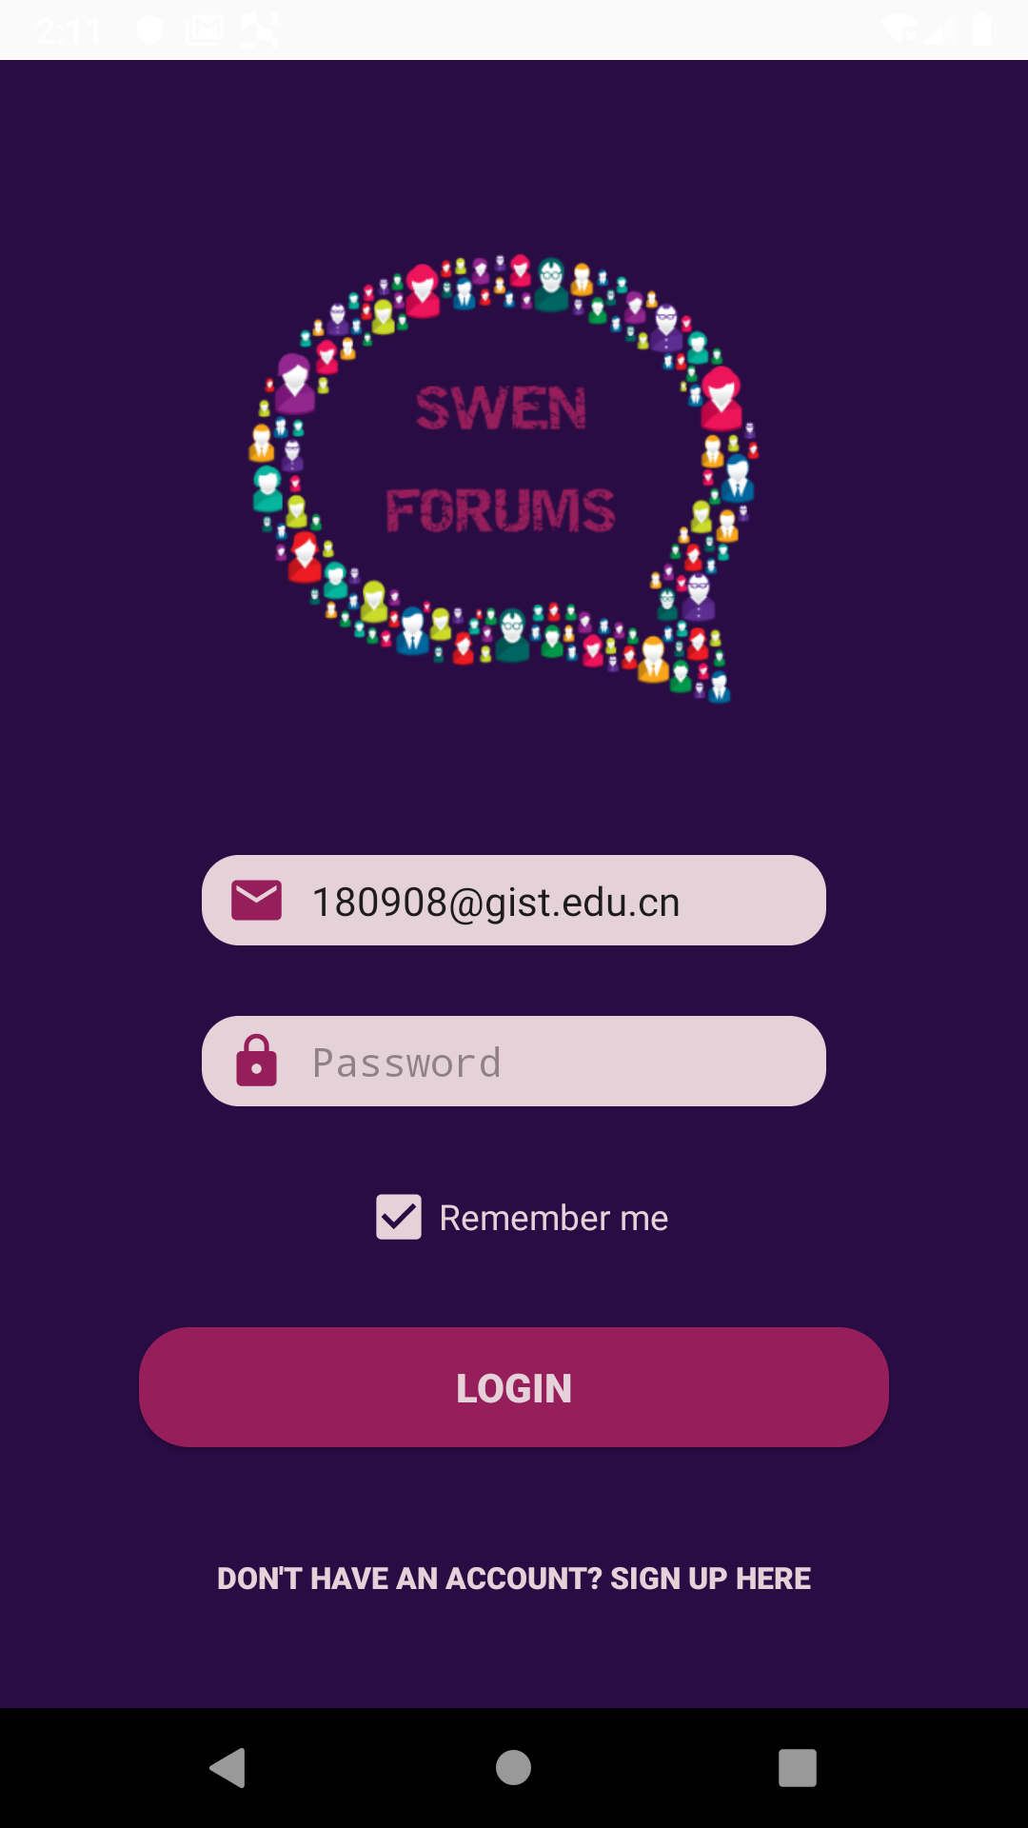
USER AUTHENTICATION
LOGIN

Slide 14
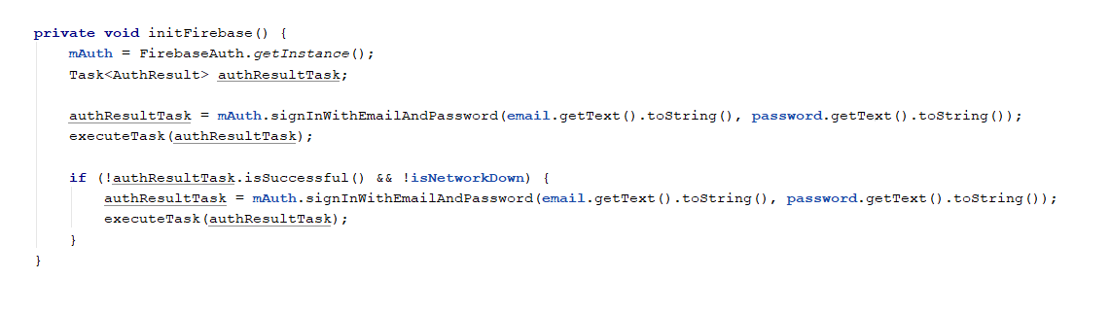
USER AUTHENTICATION - SEED AUTHENTICATION

Slide 15
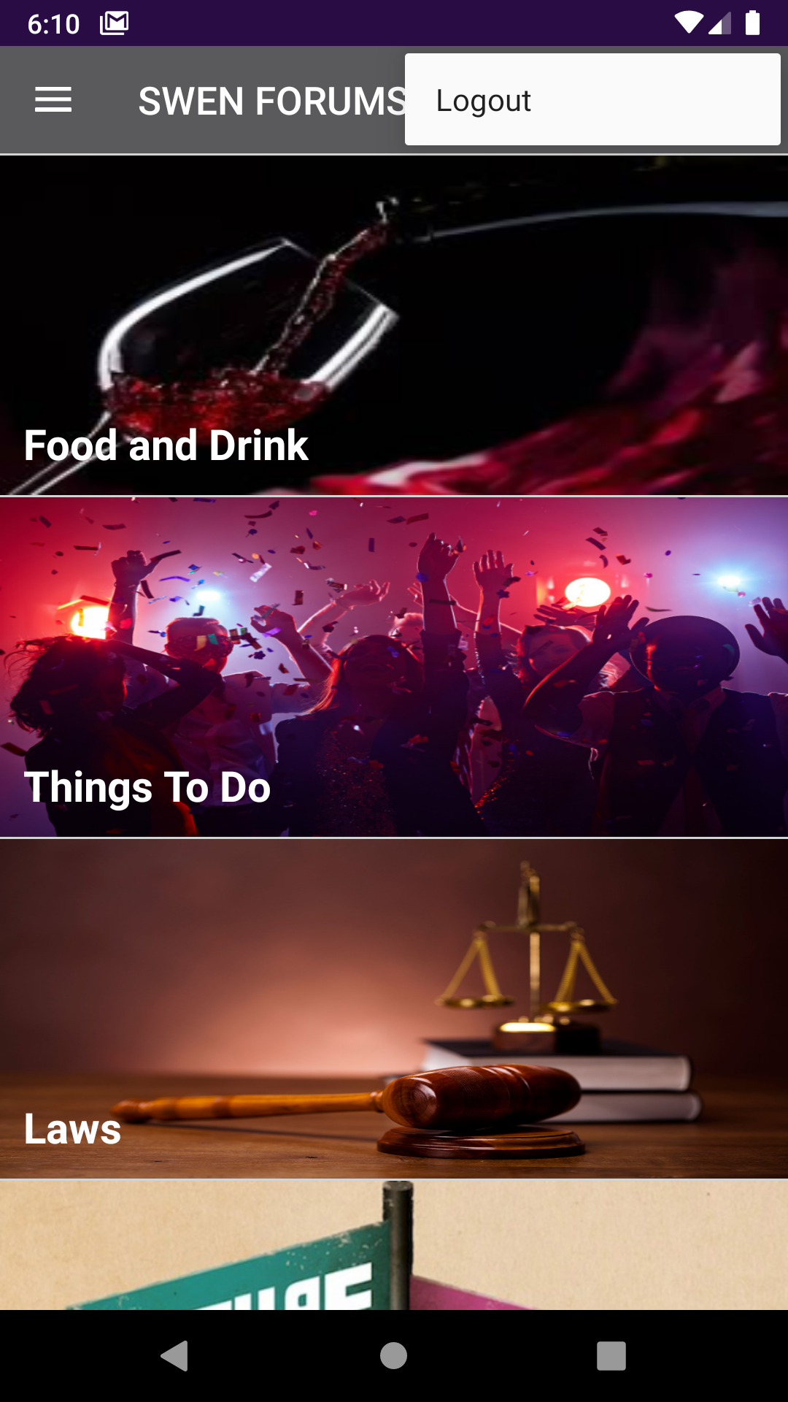
USER AUTHENTICATION
LOGOUT

Slide 16
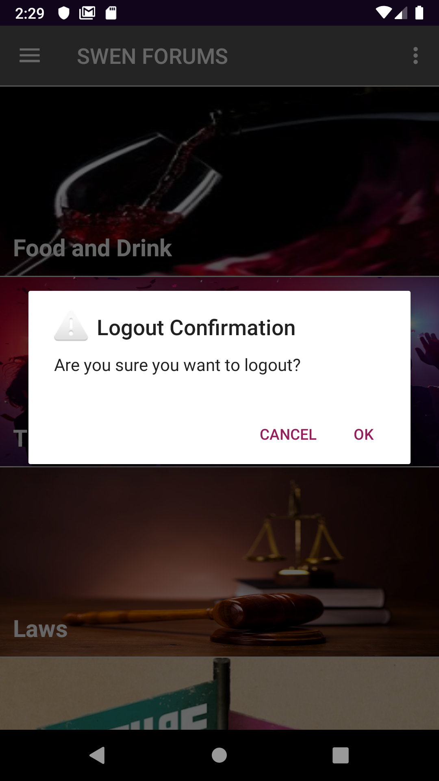
USER AUTHENTICATION
LOGOUT CONFIRMATION DIALOG

Slide 17
BREAKDOWN OF APPLICATION (cont’d)
CATEGORIES

Slide 18
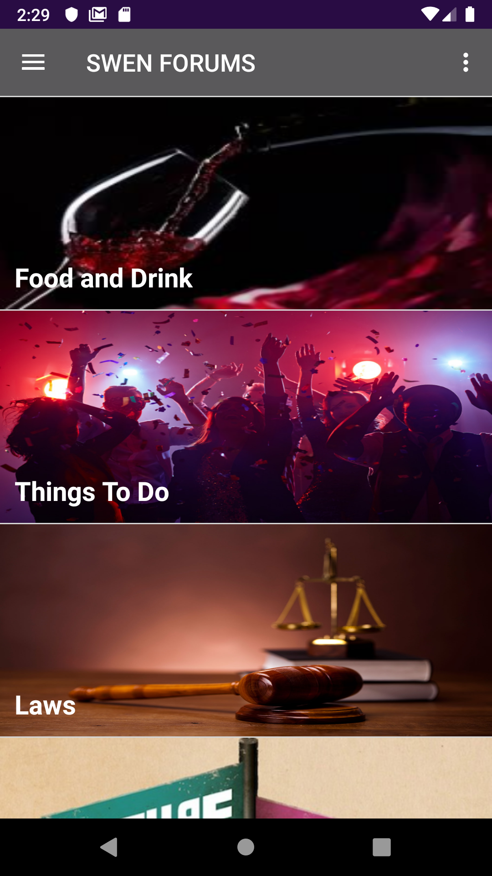
CATEGORIES
CATEGORY SELECTION

Slide 19
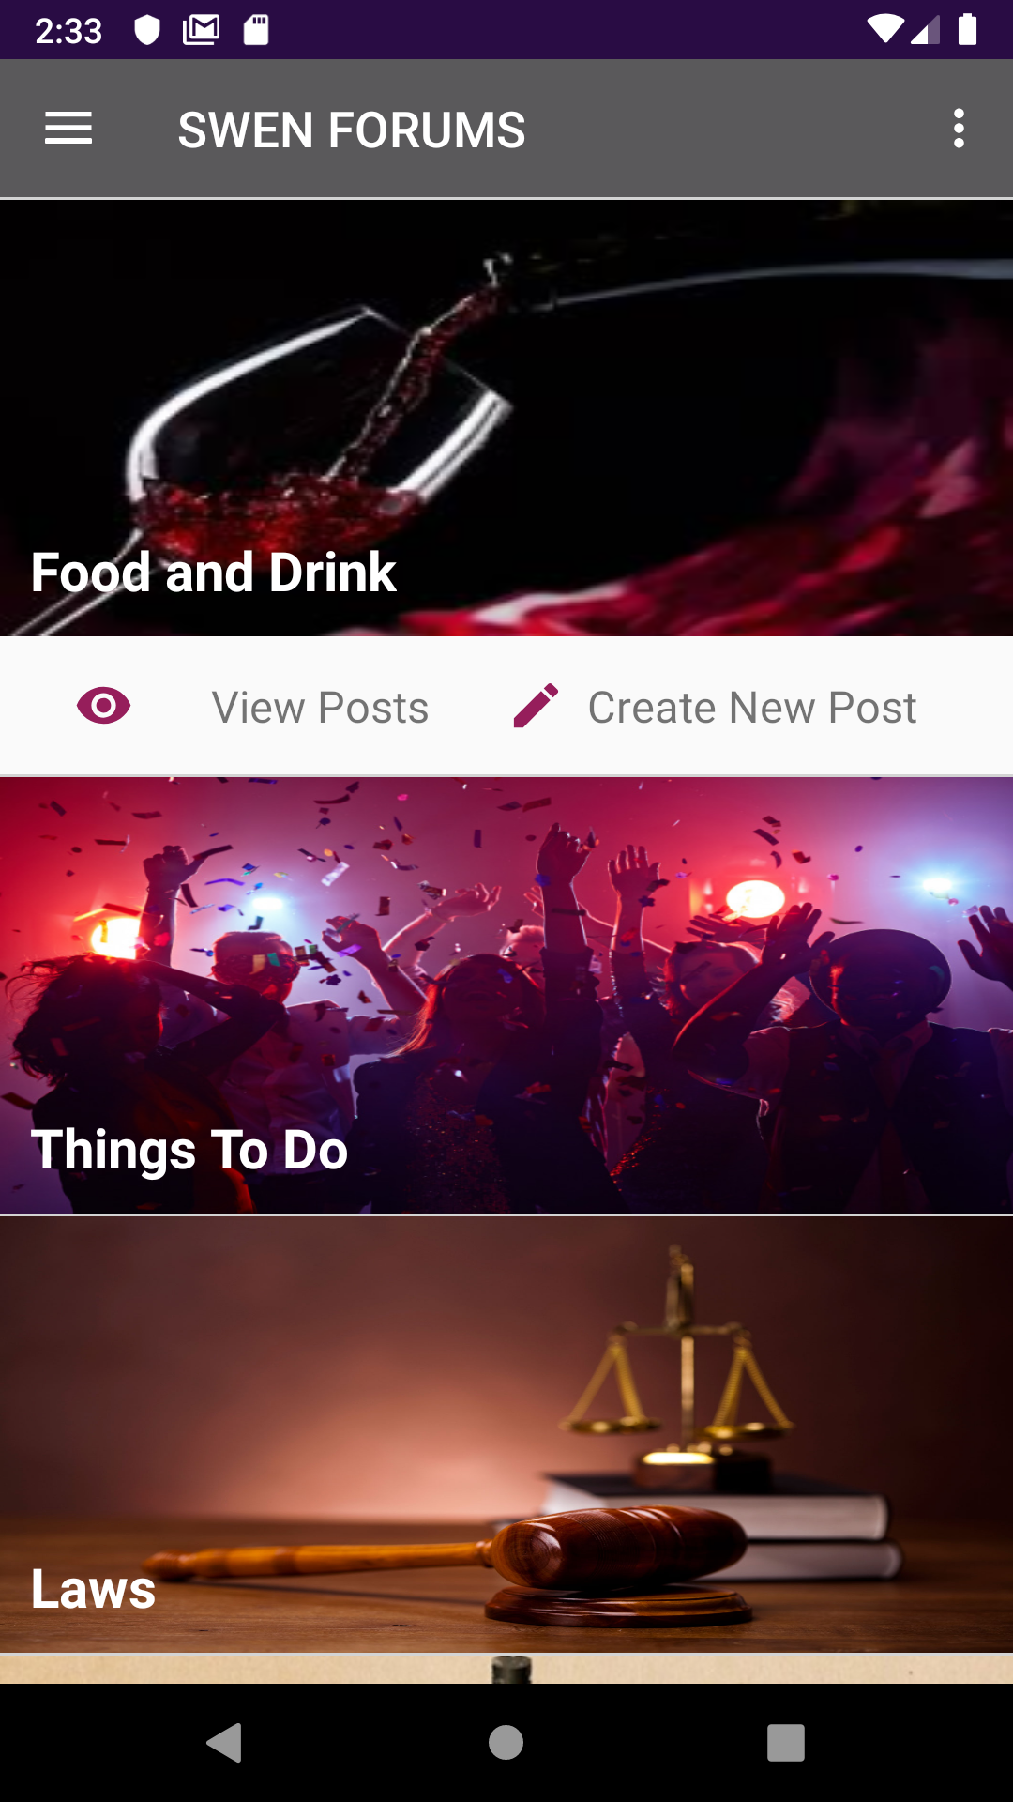
CATEGORIES
CATEGORY ACTIONS

Slide 20
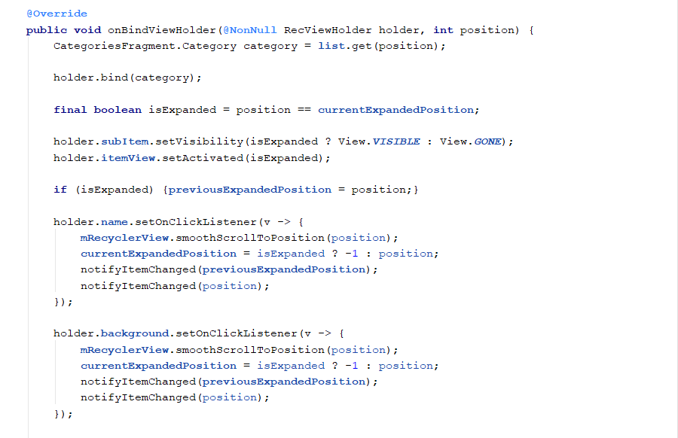
USER AUTHENTICATION - SEED AUTHENTICATION

Slide 21
BREAKDOWN OF APPLICATION (cont’d)
CREATING A POST

Slide 22
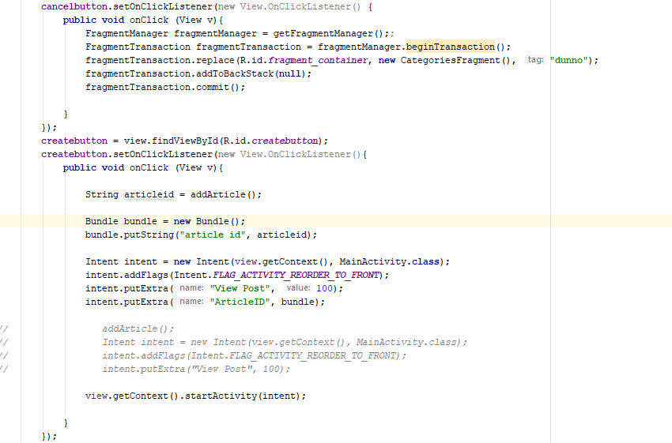
CREATING A POST
Implementation

Slide 23
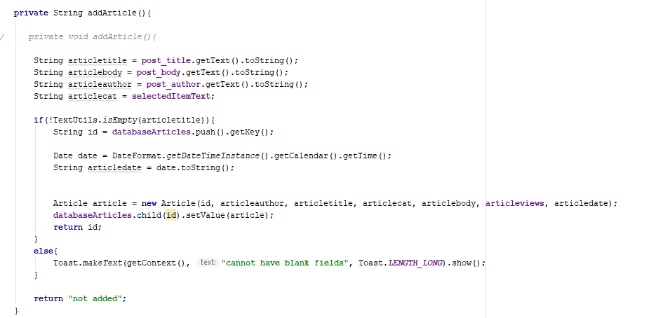
CREATING A POST
Adding to the Database

Slide 24
BREAKDOWN OF APPLICATION (cont’d)
VIEW ALL POSTS

Slide 25
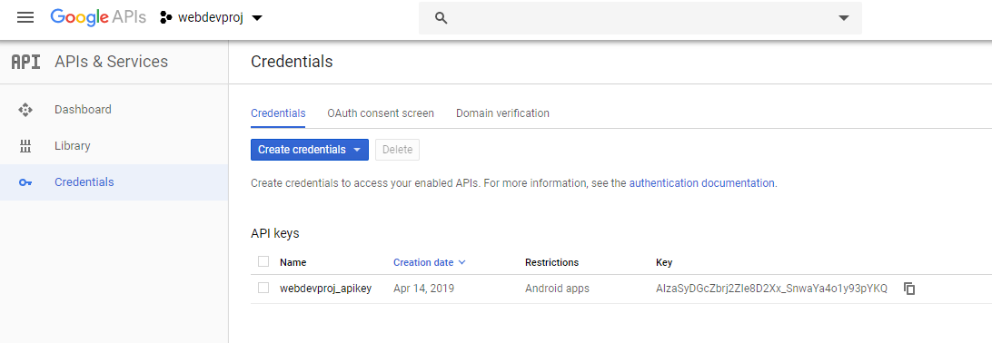
VIEW ALL POSTS
YouTube API Key

Slide 26
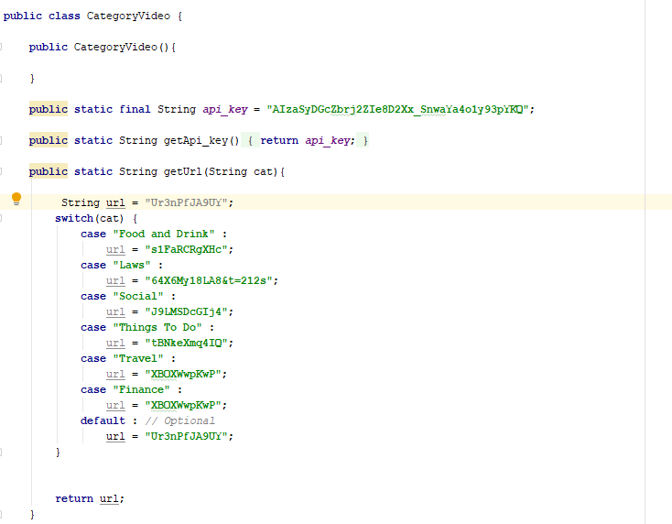
VIEW ALL POSTS
YouTube Video For Each Category

Slide 27
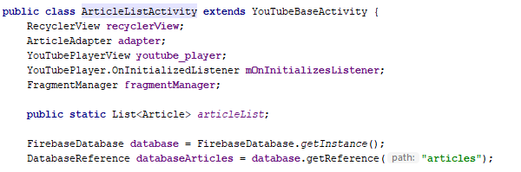
VIEW ALL POSTS
Implementation of YouTube Activity

Slide 28
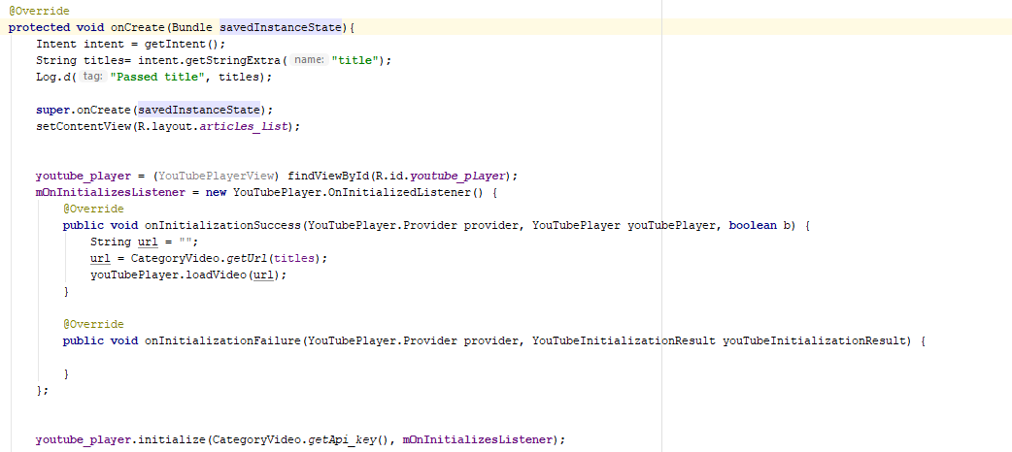
VIEW ALL POSTS
Implementation of YouTube Activity

Slide 29
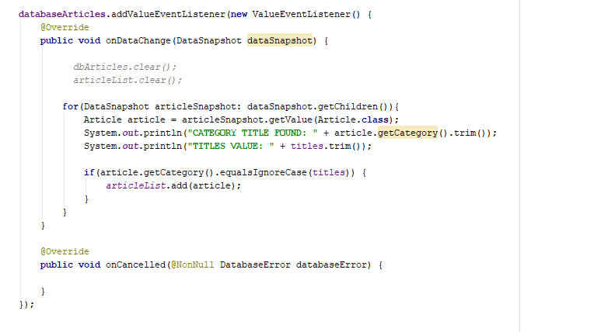
VIEW ALL POSTS
Loading From Database

Slide 30
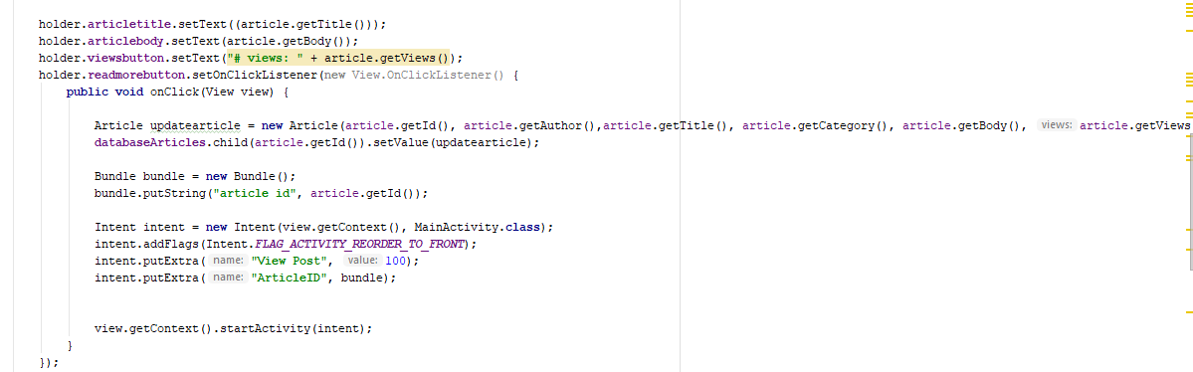
VIEW ALL POSTS
Updating view count + launching a fragment from the adapter

Slide 31
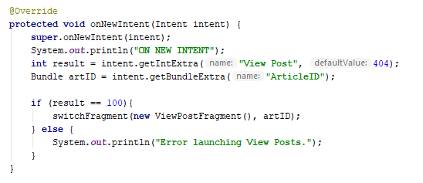
VIEW ALL POSTS
Launching a fragment from MainActivity

Slide 32
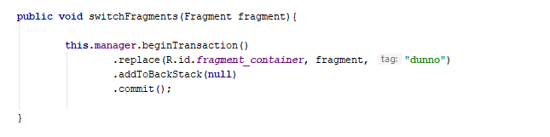
VIEW ALL POSTS
Implementation of Switching Fragments

Slide 33
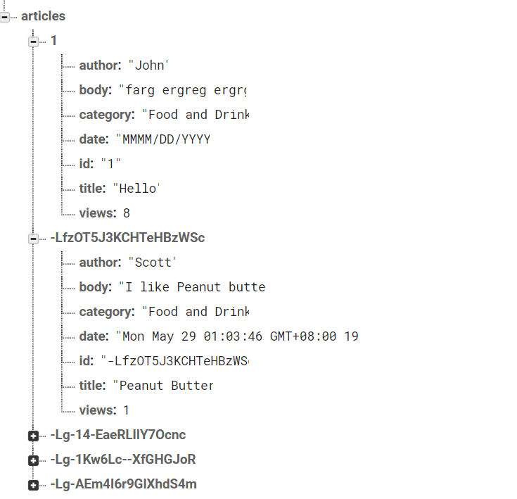
VIEW ALL POSTS
Database View

Slide 34
BREAKDOWN OF APPLICATION (cont’d)
VIEW A POST

Slide 35
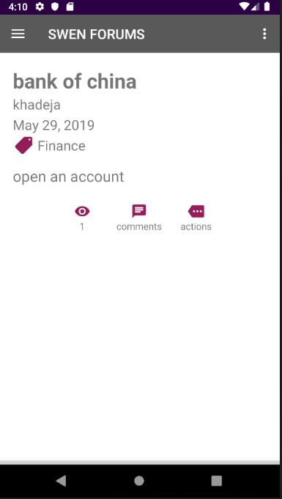
VIEW POST
APPLICATION

Slide 36
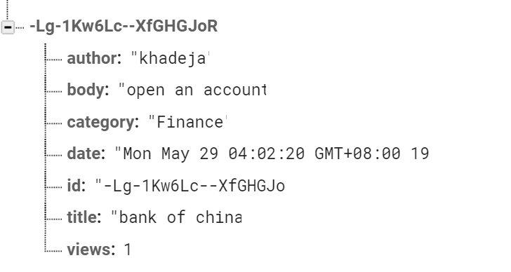
VIEW POST
DATABASE

Slide 37
BREAKDOWN OF APPLICATION (cont’d)
COMMENTS

Slide 38
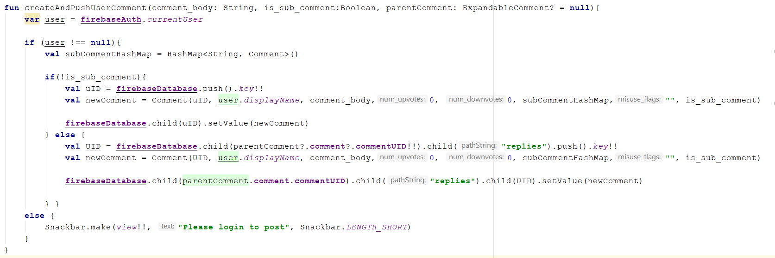
COMMENTS
Creating a comment and pushing to database

Slide 39
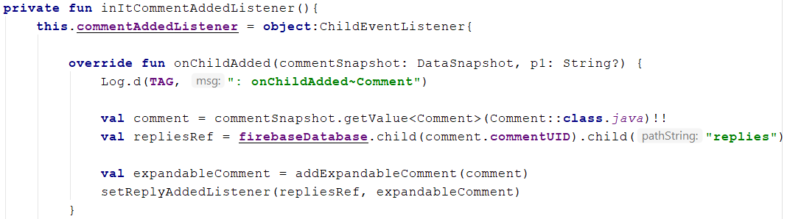
COMMENTS
Listener for new comments added to database

Slide 40
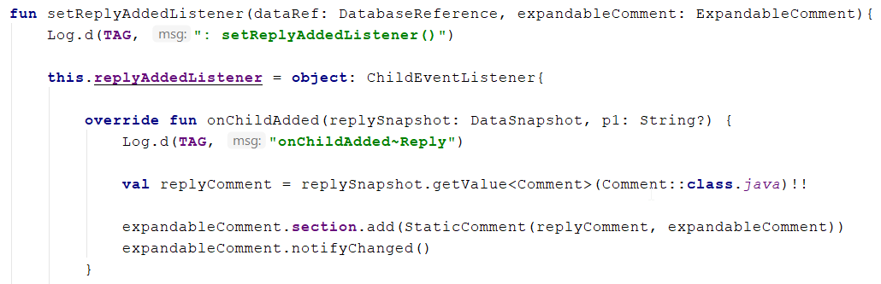
COMMENTS
Listener for new reply added to database

Slide 41
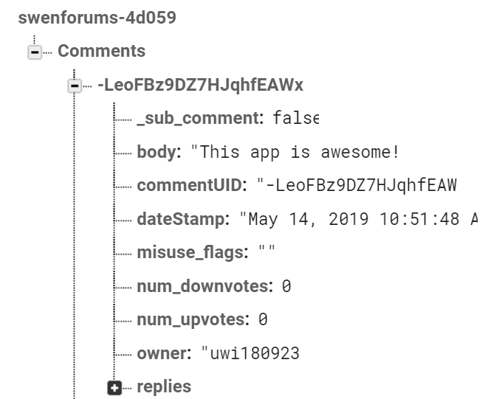
COMMENTS
Table structure in database

Slide 42
QUESTIONS and COMMENTS

